Slide 1
States and Capitals
Flash Cards
© Brent Coley 2008 | www.mrcoley.com

Slide 2
Week 1

Slide 3
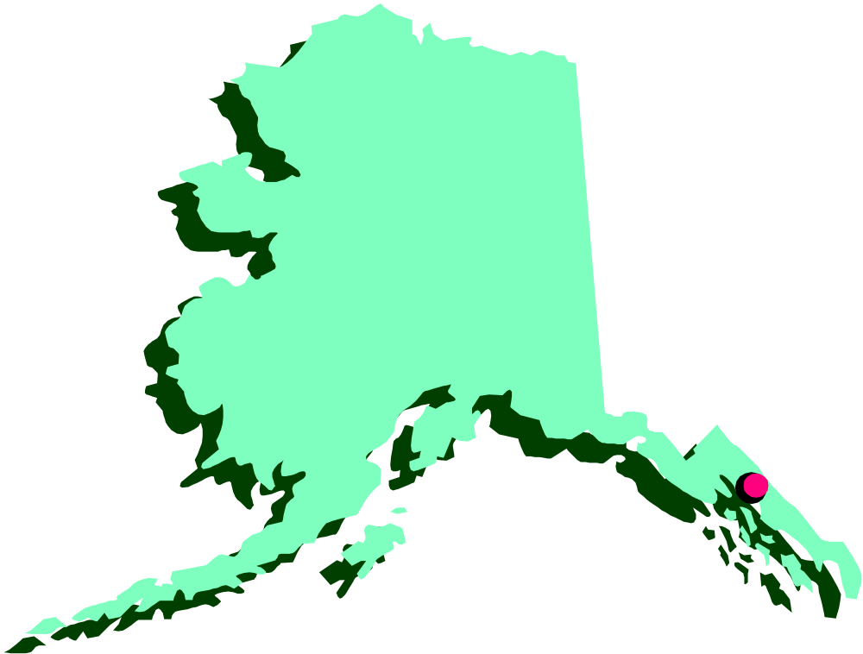
Alaska

Slide 4
Alaska
Capital:
Juneau
Abbreviation:
AK

Slide 5
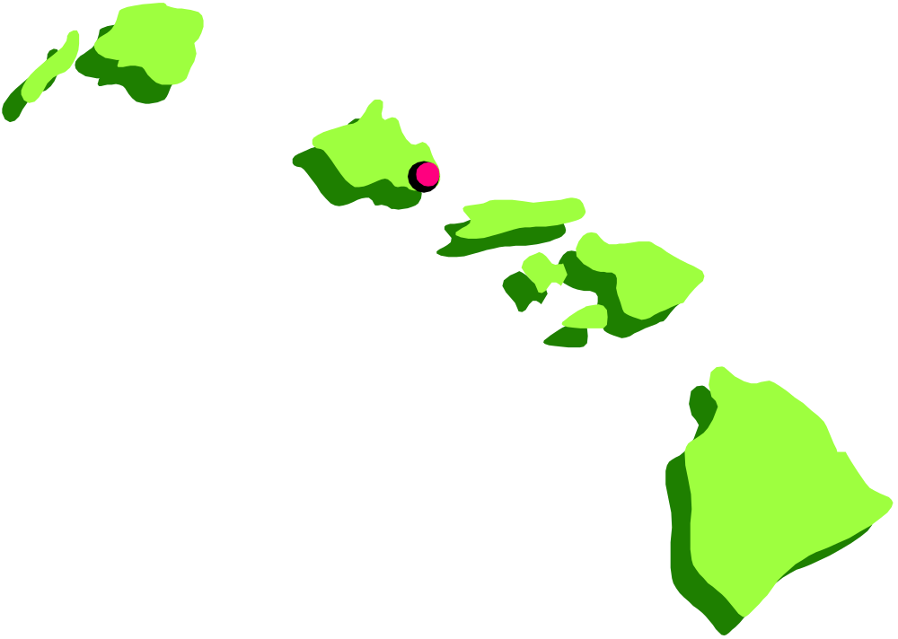
Hawaii

Slide 6
Hawaii
Capital:
Honolulu
Abbreviation:
HI

Slide 7
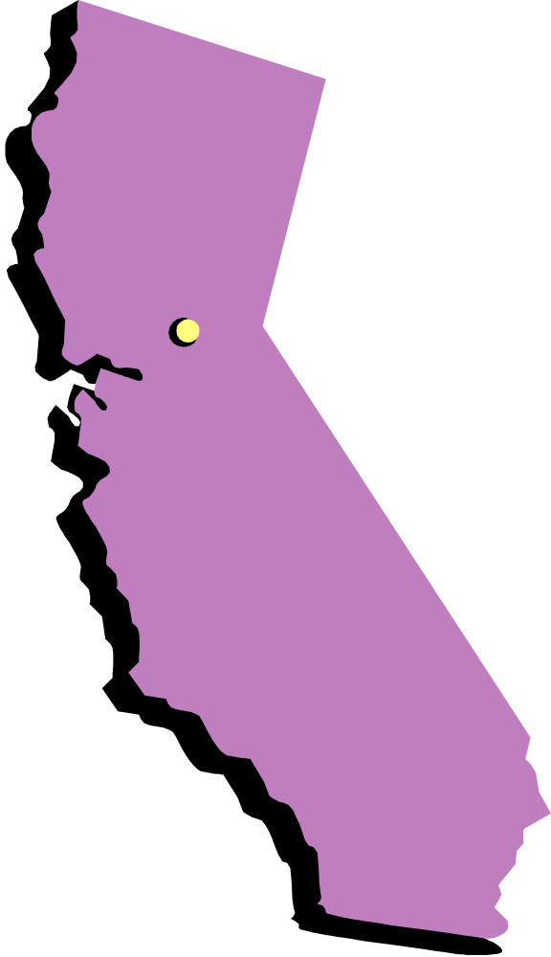
California

Slide 8
California
Capital:
Sacramento
Abbreviation:
CA

Slide 9

Nevada

Slide 10
Nevada
Capital:
Carson City
Abbreviation:
NV

Slide 11
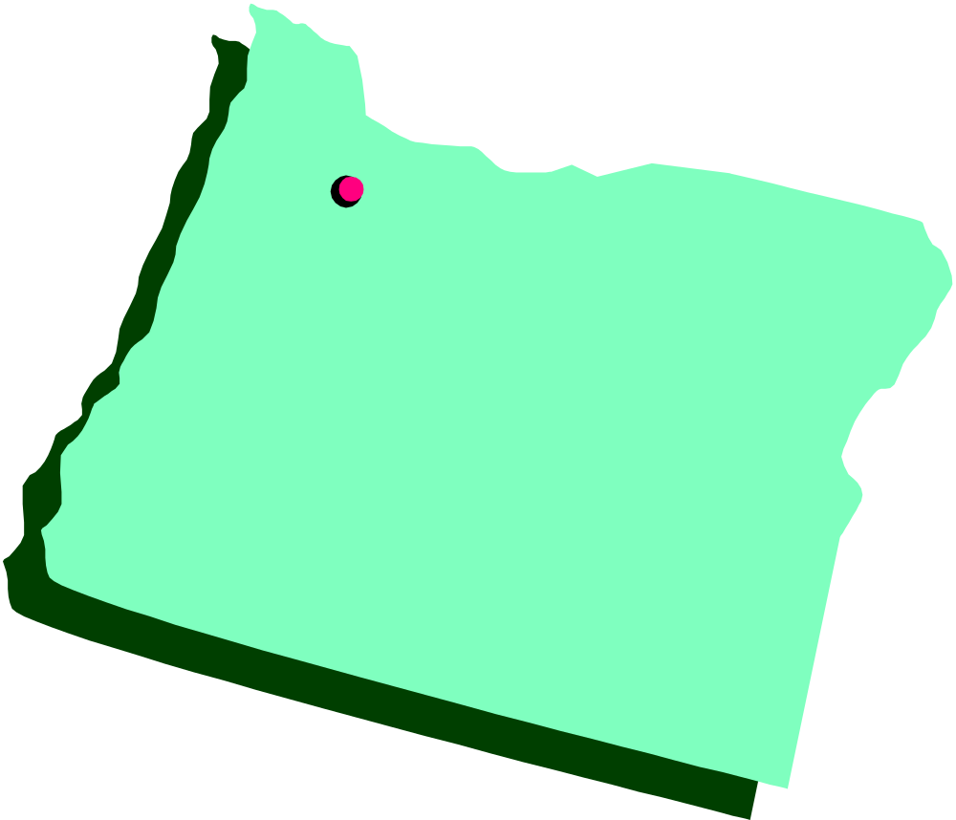
Oregon

Slide 12
Oregon
Capital:
Salem
Abbreviation:
OR

Slide 13
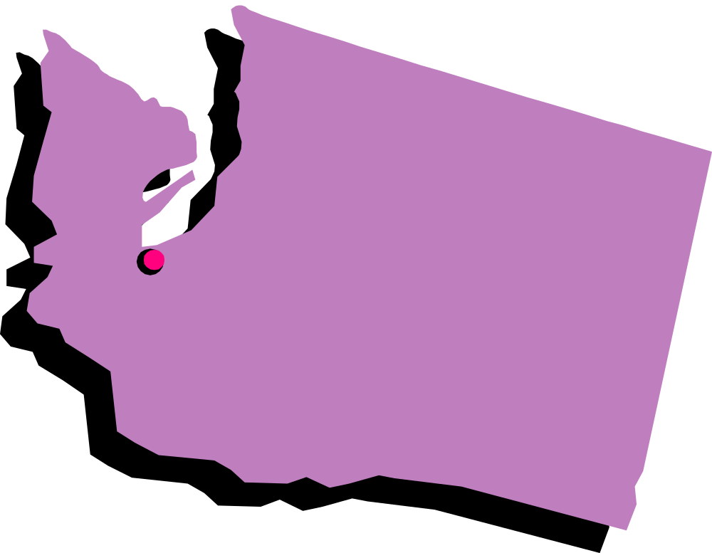
Washington

Slide 14
Washington
Capital:
Olympia
Abbreviation:
WA

Slide 15
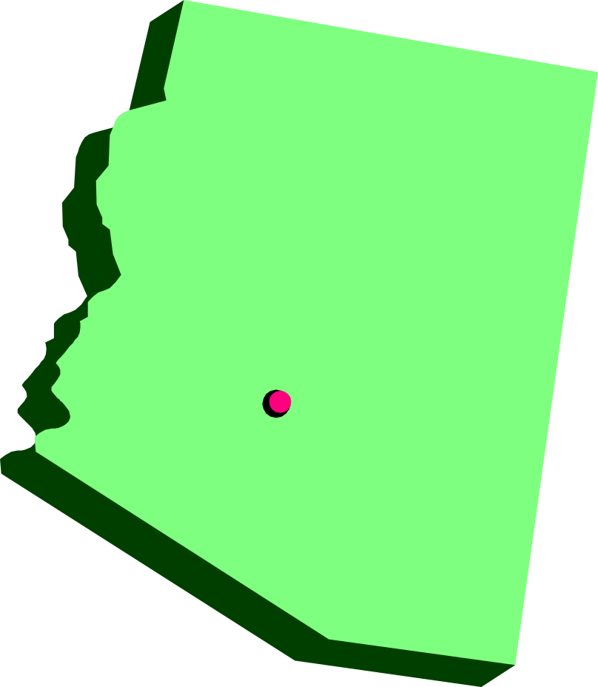
Arizona

Slide 16
Arizona
Capital:
Phoenix
Abbreviation:
AZ

Slide 17
Week 2

Slide 18

Utah

Slide 19
Utah
Capital:
Salt Lake City
Abbreviation:
UT

Slide 20
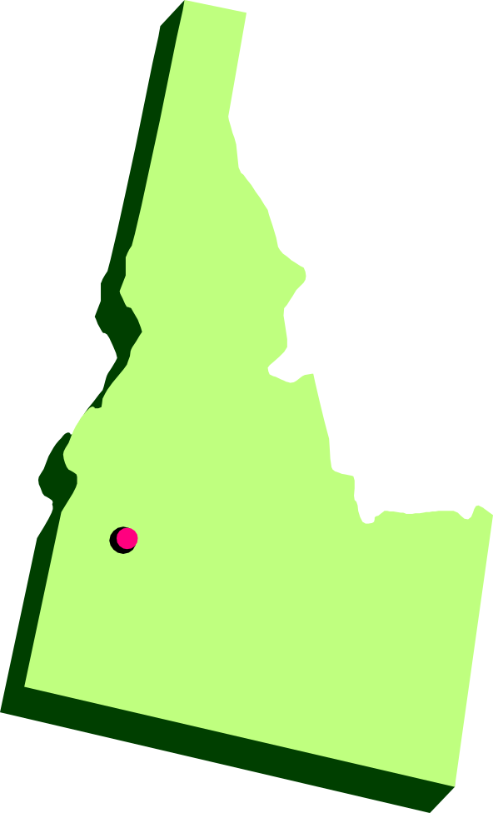
Idaho

Slide 21
Idaho
Capital:
Boise
Abbreviation:
ID

Slide 22
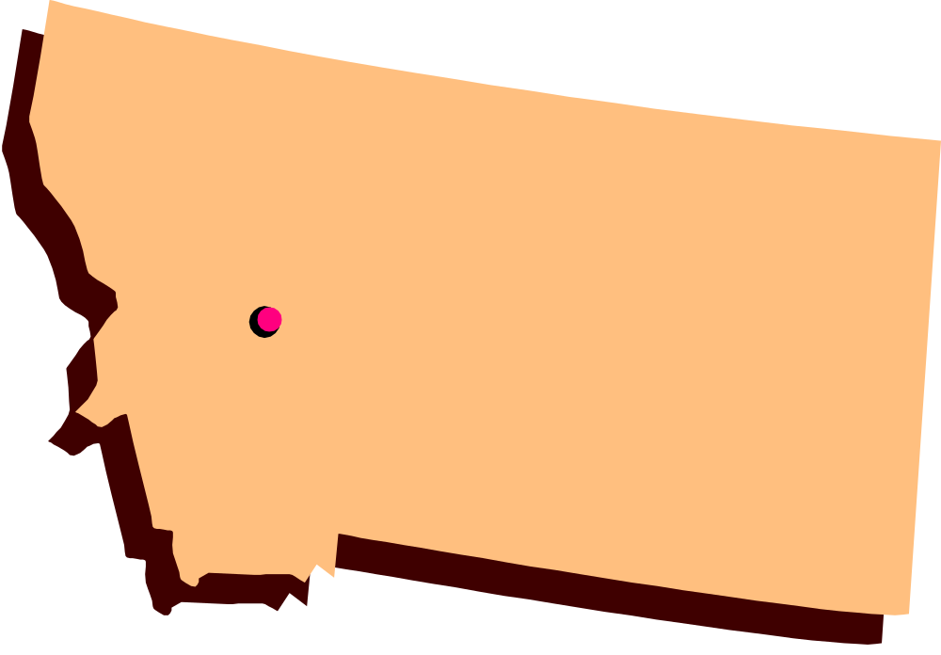
Montana

Slide 23
Montana
Capital:
Helena
Abbreviation:
MT

Slide 24

Wyoming

Slide 25
Wyoming
Capital:
Cheyenne
Abbreviation:
WY

Slide 26

Colorado

Slide 27
Colorado
Capital:
Denver
Abbreviation:
CO

Slide 28

New Mexico

Slide 29
New Mexico
Capital:
Santa Fe
Abbreviation:
NM

Slide 30
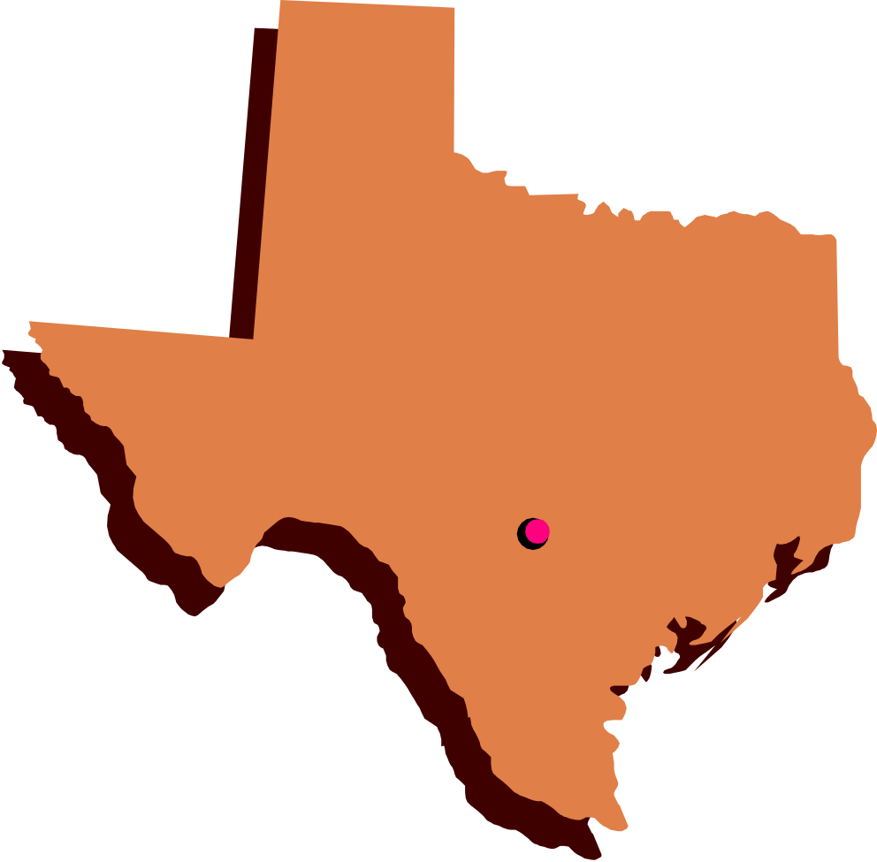
Texas

Slide 31
Texas
Capital:
Austin
Abbreviation:
TX

Slide 32
Week 3

Slide 33

North Dakota

Slide 34
North Dakota
Capital:
Bismarck
Abbreviation:
ND

Slide 35
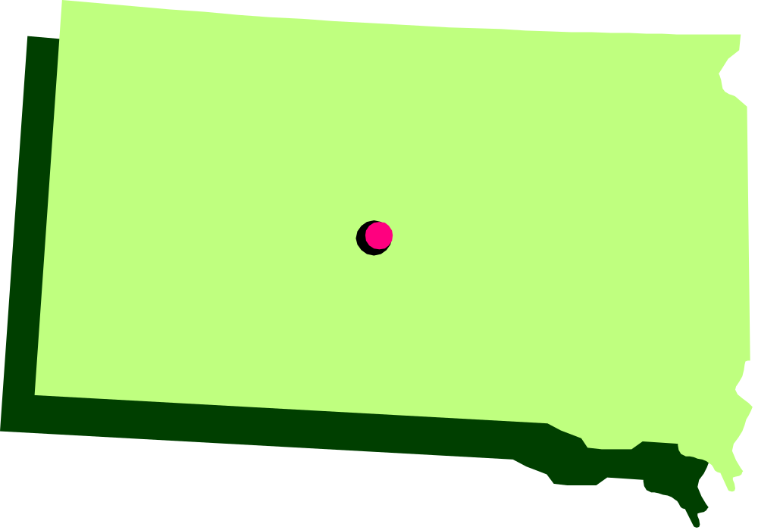
South Dakota

Slide 36
South Dakota
Capital:
Pierre
Abbreviation:
SD

Slide 37

Nebraska

Slide 38
Nebraska
Capital:
Lincoln
Abbreviation:
NE

Slide 39

Kansas

Slide 40
Kansas
Capital:
Topeka
Abbreviation:
KS

Slide 41
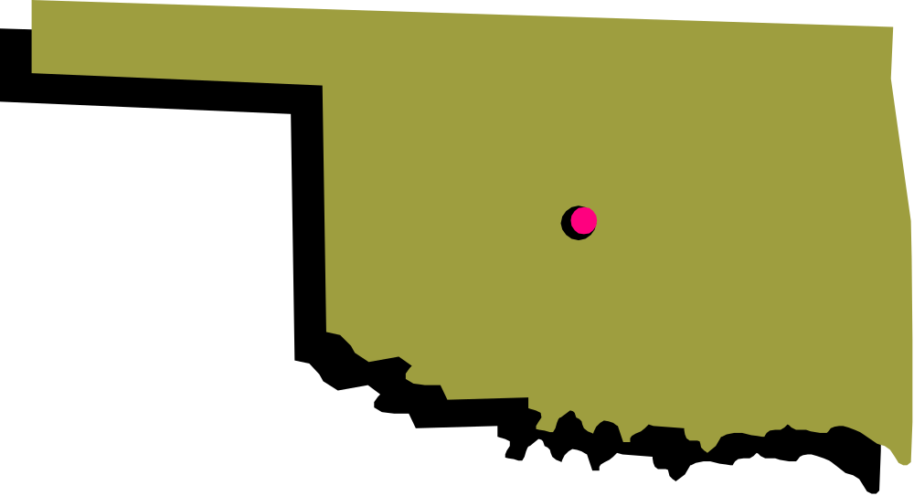
Oklahoma

Slide 42
Oklahoma
Capital:
Oklahoma City
Abbreviation:
OK

Slide 43
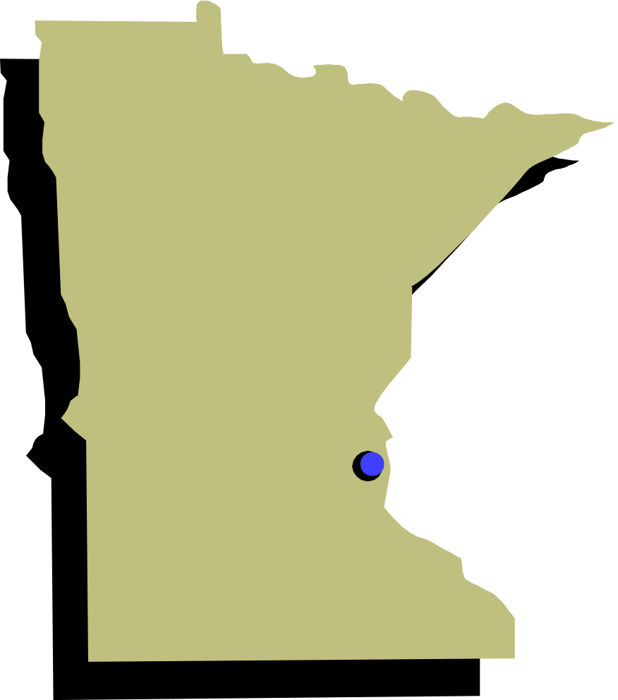
Minnesota

Slide 44
Minnesota
Capital:
St. Paul
Abbreviation:
MN

Slide 45
Week 4

Slide 46
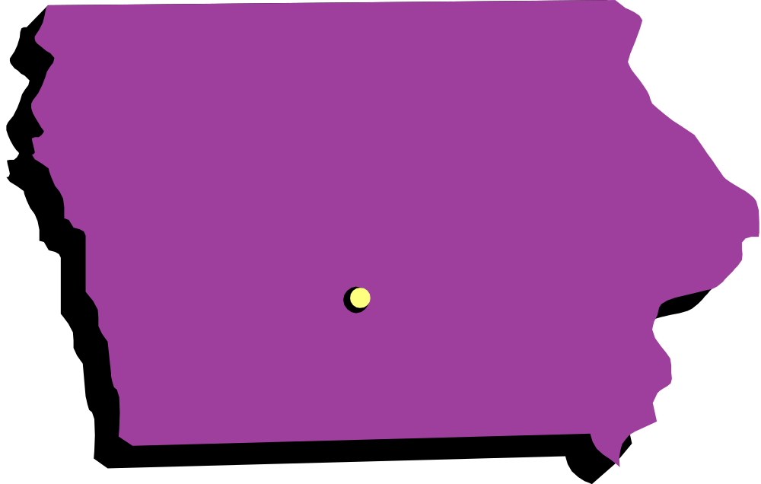
Iowa

Slide 47
Iowa
Capital:
Des Moines
Abbreviation:
IA

Slide 48
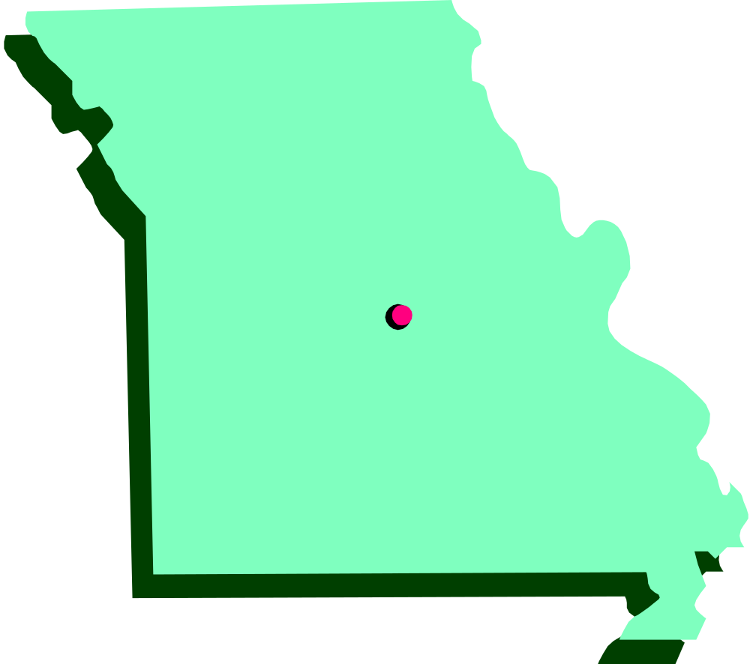
Missouri

Slide 49
Missouri
Capital:
Jefferson City
Abbreviation:
MO

Slide 50
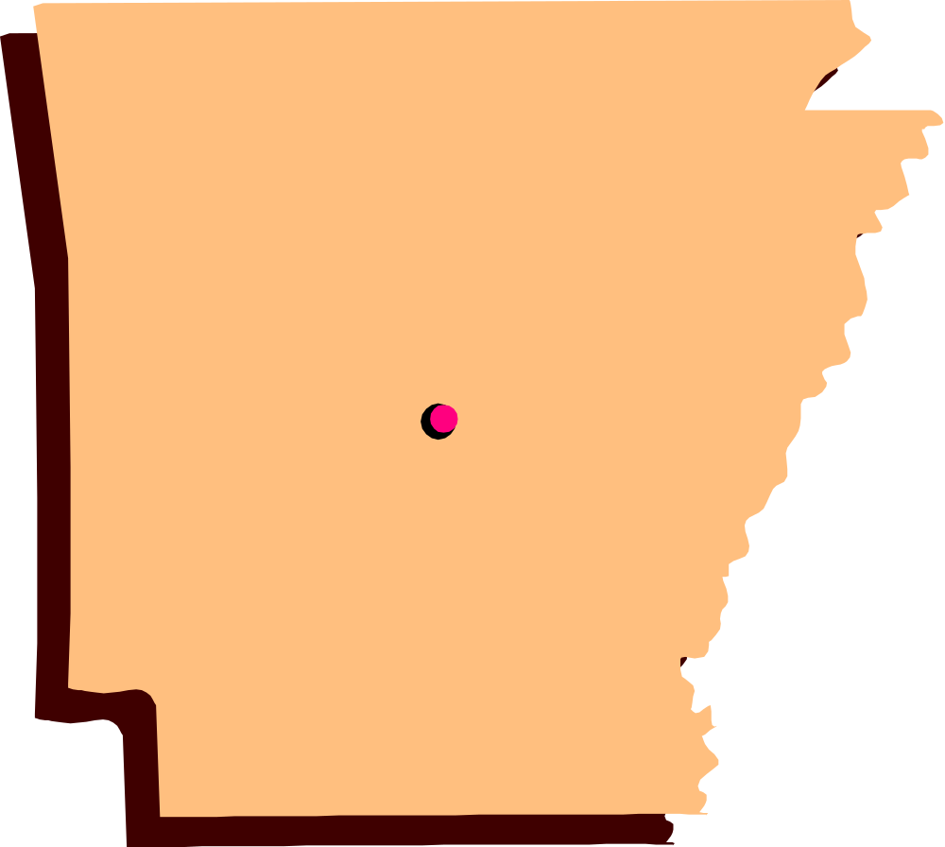
Arkansas

Slide 51
Arkansas
Capital:
Little Rock
Abbreviation:
AR

Slide 52
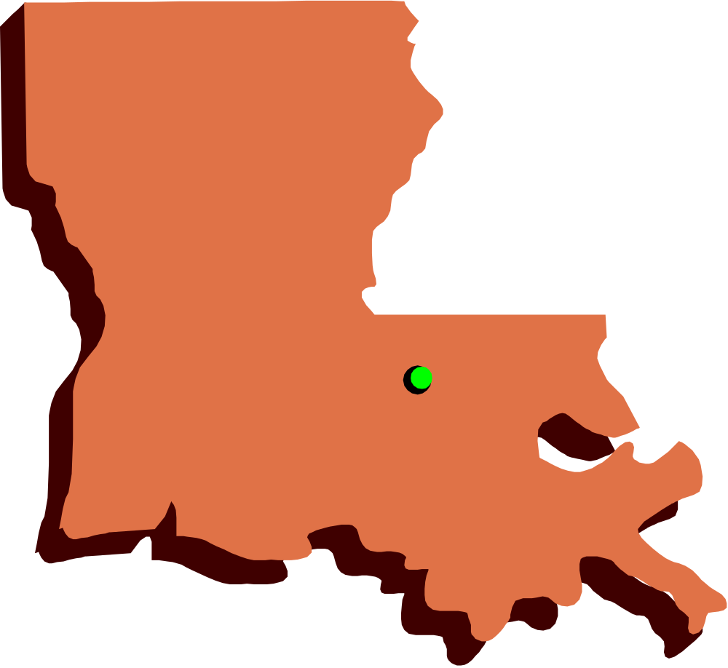
Louisiana

Slide 53
Louisiana
Capital:
Baton Rouge
Abbreviation:
LA

Slide 54
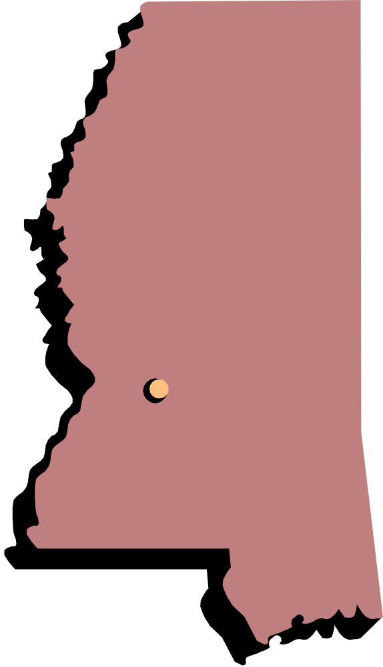
Mississippi

Slide 55
Mississippi
Capital:
Jackson
Abbreviation:
MS

Slide 56

Alabama

Slide 57
Alabama
Capital:
Montgomery
Abbreviation:
AL

Slide 58
Week 5

Slide 59
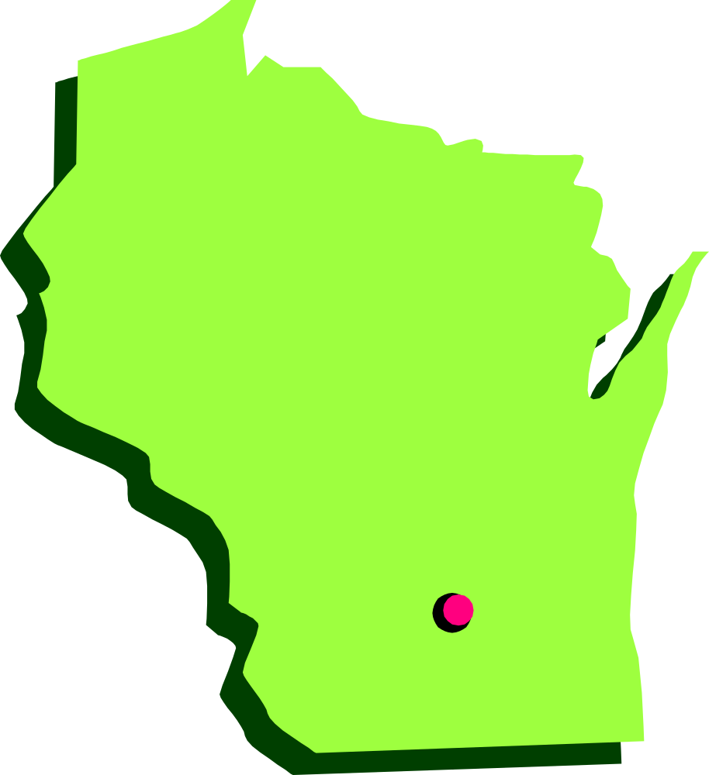
Wisconsin

Slide 60
Wisconsin
Capital:
Madison
Abbreviation:
WI

Slide 61
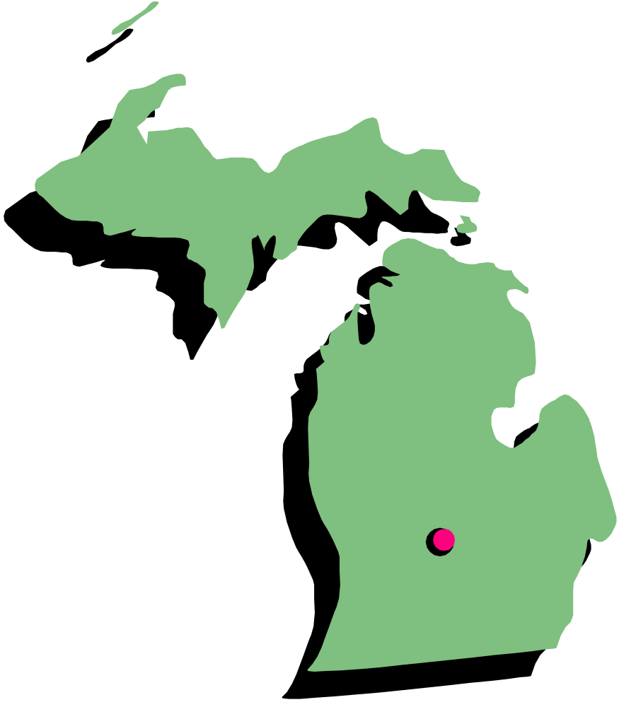
Michigan

Slide 62
Michigan
Capital:
Lansing
Abbreviation:
MI

Slide 63
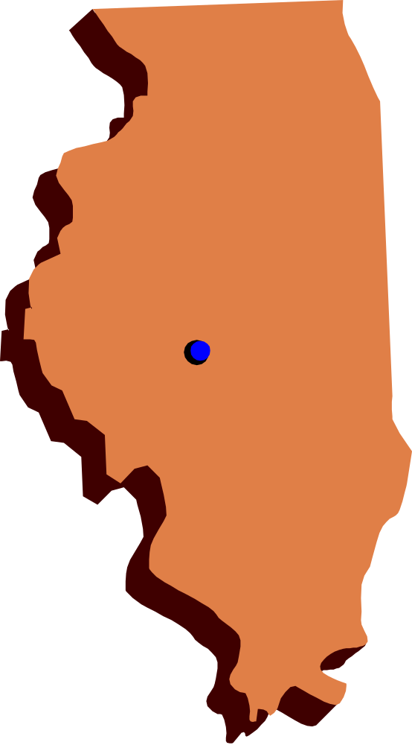
Illinois

Slide 64
Illinois
Capital:
Springfield
Abbreviation:
IL

Slide 65

Indiana

Slide 66
Indiana
Capital:
Indianapolis
Abbreviation:
IN

Slide 67
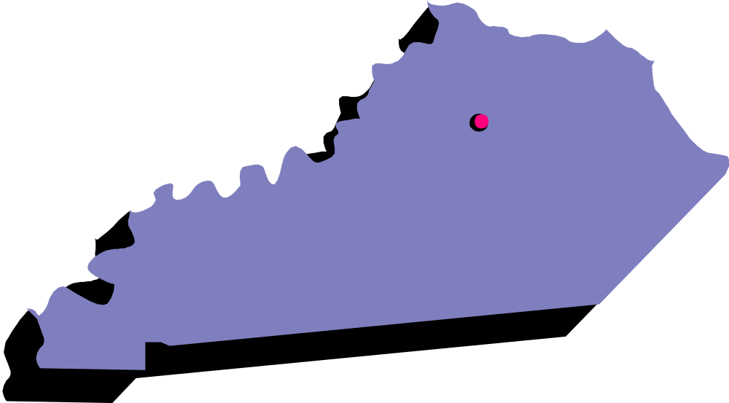
Kentucky

Slide 68
Kentucky
Capital:
Frankfort
Abbreviation:
KY

Slide 69

Tennessee

Slide 70
Tennessee
Capital:
Nashville
Abbreviation:
TN

Slide 71
Week 6

Slide 72
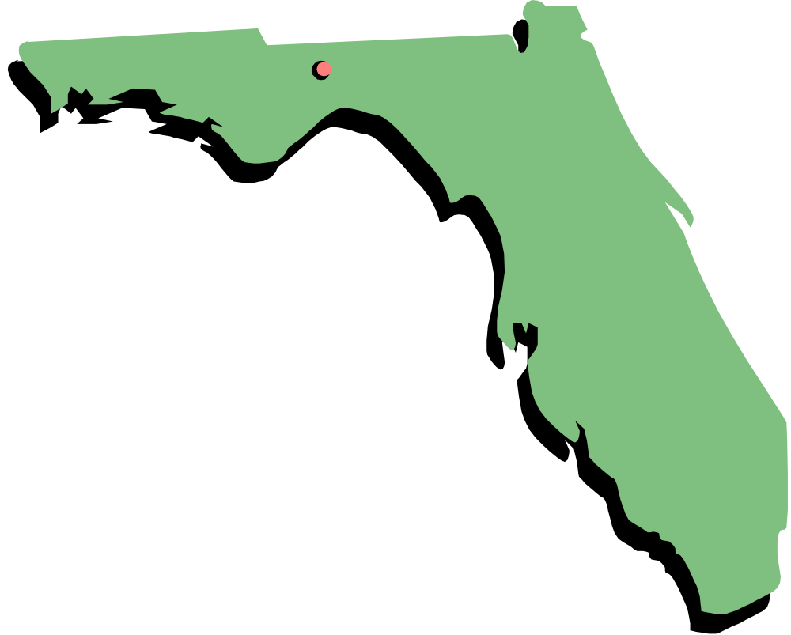
Florida

Slide 73
Florida
Capital:
Tallahassee
Abbreviation:
FL

Slide 74
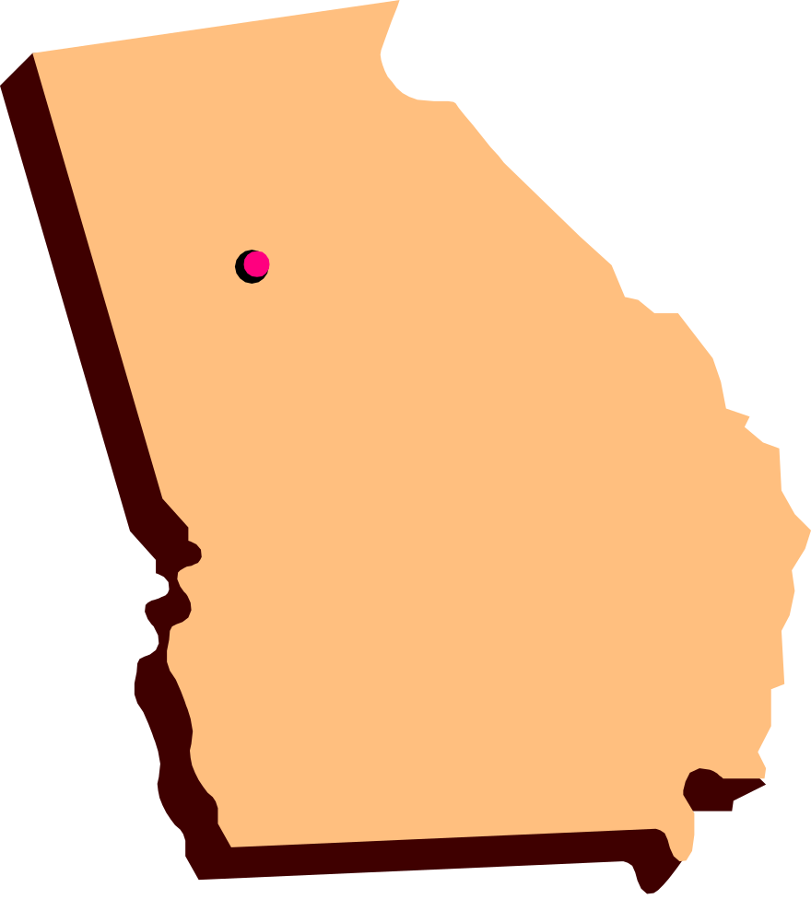
Georgia

Slide 75
Georgia
Capital:
Atlanta
Abbreviation:
GA

Slide 76
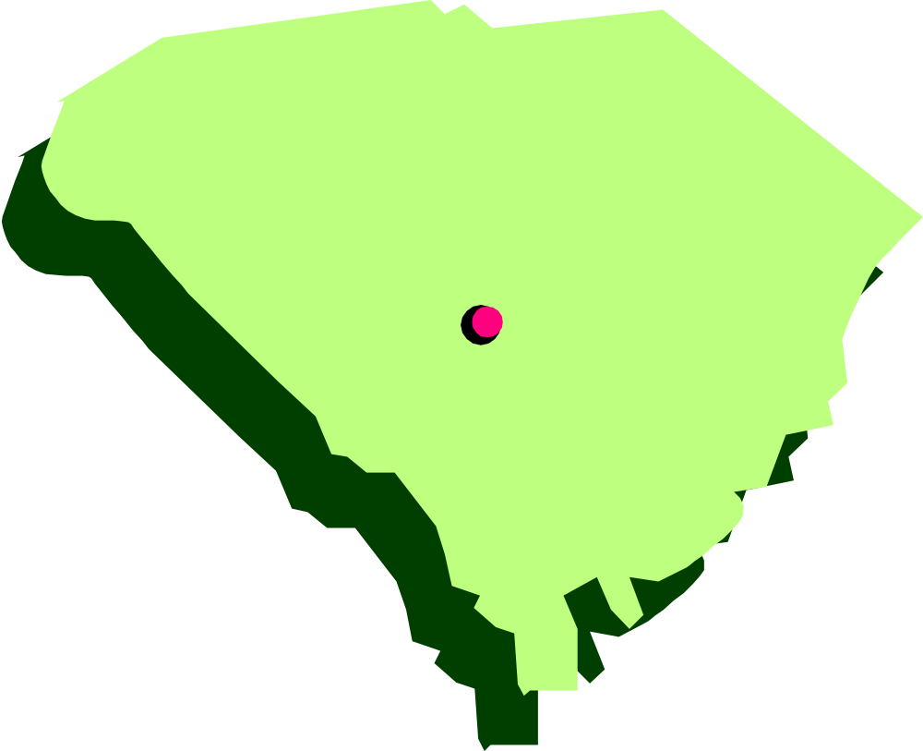
South Carolina

Slide 77
South Carolina
Capital:
Columbia
Abbreviation:
SC

Slide 78
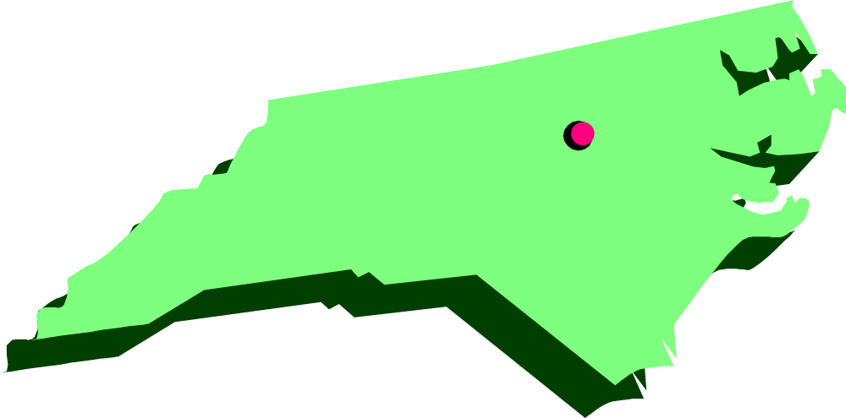
North Carolina

Slide 79
North Carolina
Capital:
Raleigh
Abbreviation:
NC

Slide 80

Virginia

Slide 81
Virginia
Capital:
Richmond
Abbreviation:
VA

Slide 82
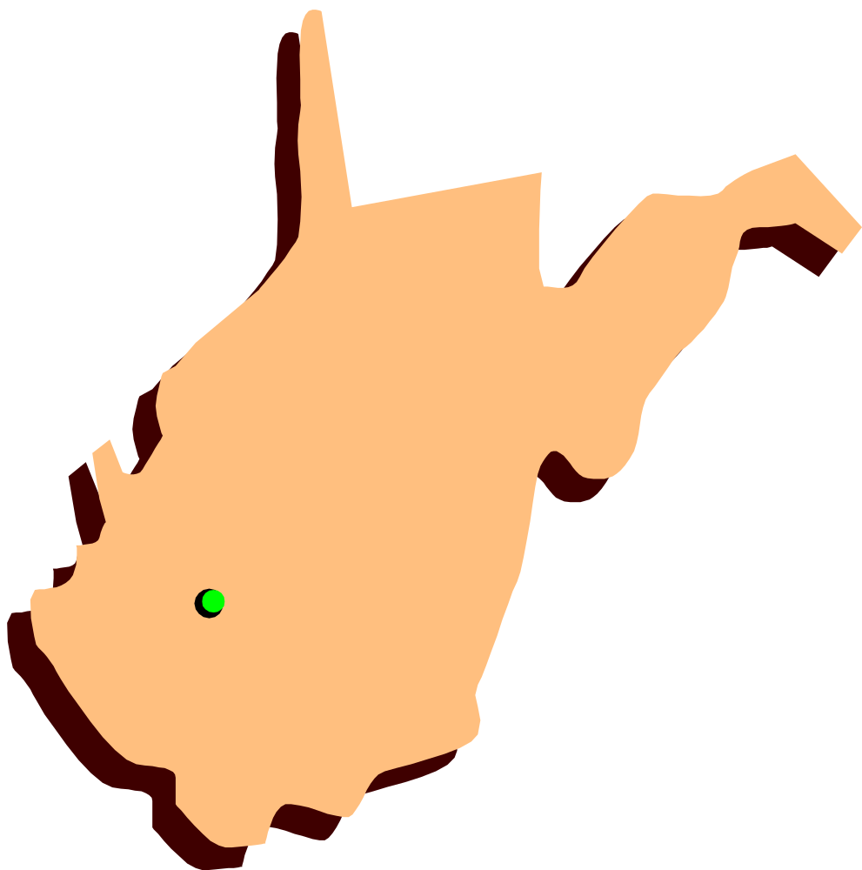
West Virginia

Slide 83
West Virginia
Capital:
Charleston
Abbreviation:
WV

Slide 84
Week 7

Slide 85
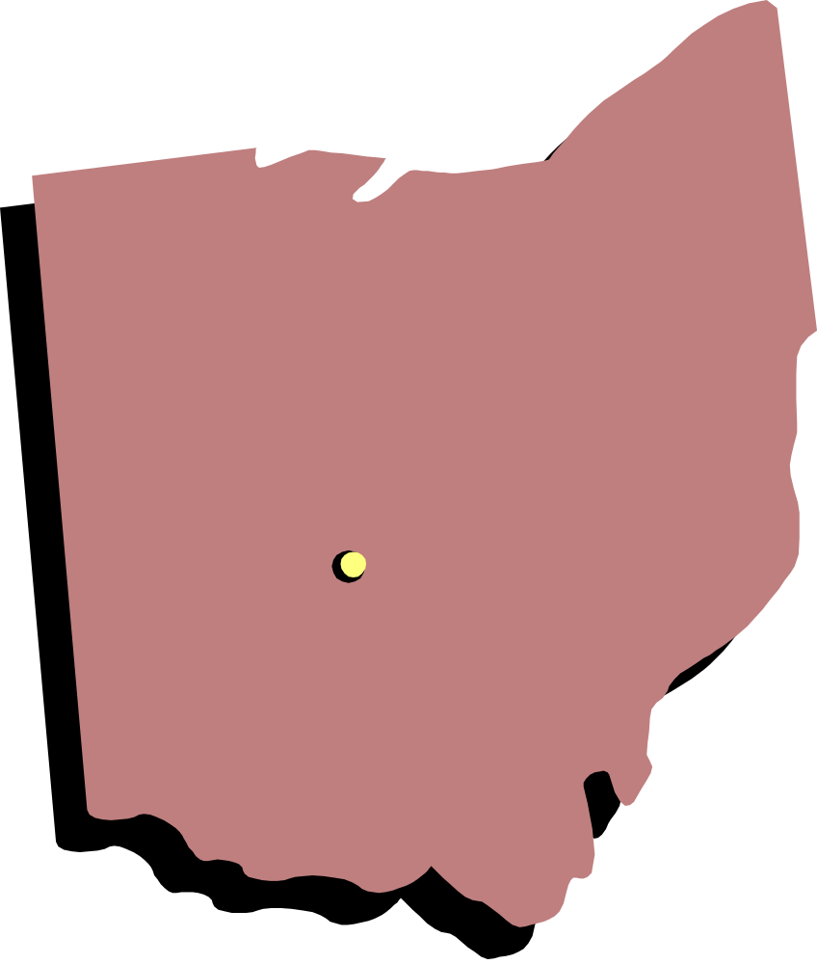
Ohio

Slide 86
Ohio
Capital:
Columbus
Abbreviation:
OH

Slide 87
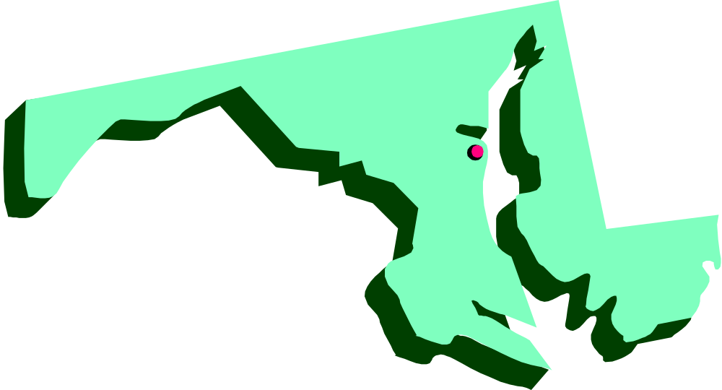
Maryland

Slide 88
Maryland
Capital:
Annapolis
Abbreviation:
MD

Slide 89

Delaware

Slide 90
Delaware
Capital:
Dover
Abbreviation:
DE

Slide 91
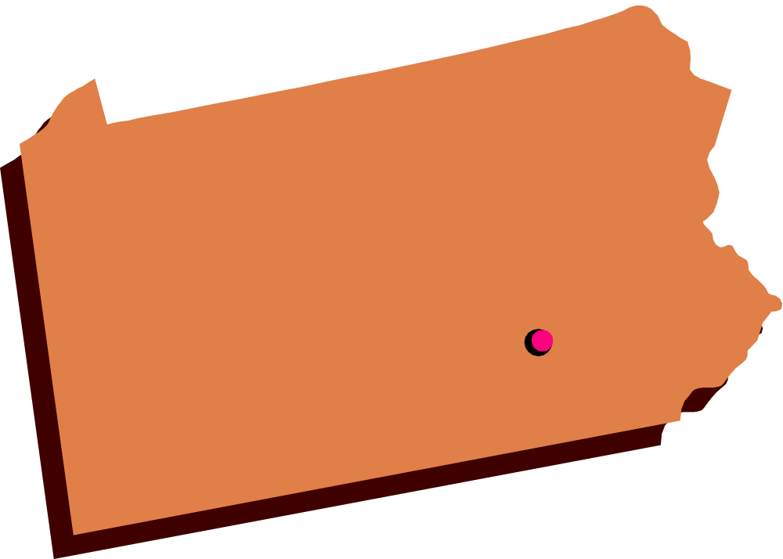
Pennsylvania

Slide 92
Pennsylvania
Capital:
Harrisburg
Abbreviation:
PA

Slide 93

New Jersey

Slide 94
New Jersey
Capital:
Trenton
Abbreviation:
NJ

Slide 95
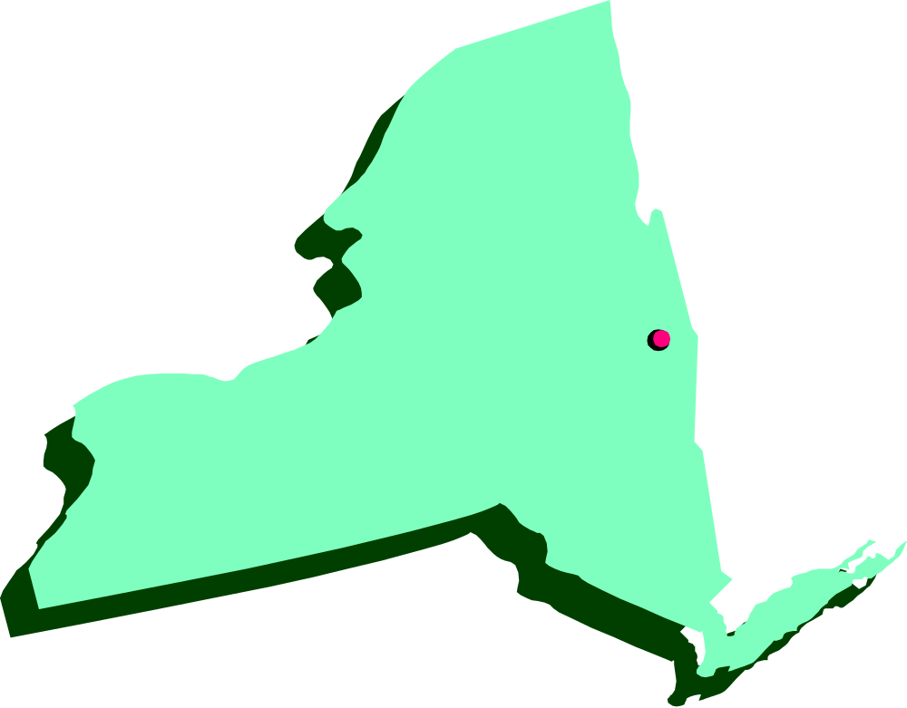
New York

Slide 96
New York
Capital:
Albany
Abbreviation:
NY

Slide 97
Week 8

Slide 98

Connecticut

Slide 99
Connecticut
Capital:
Hartford
Abbreviation:
CT

Slide 100

Rhode Island

Slide 101
Rhode Island
Capital:
Providence
Abbreviation:
RI

Slide 102
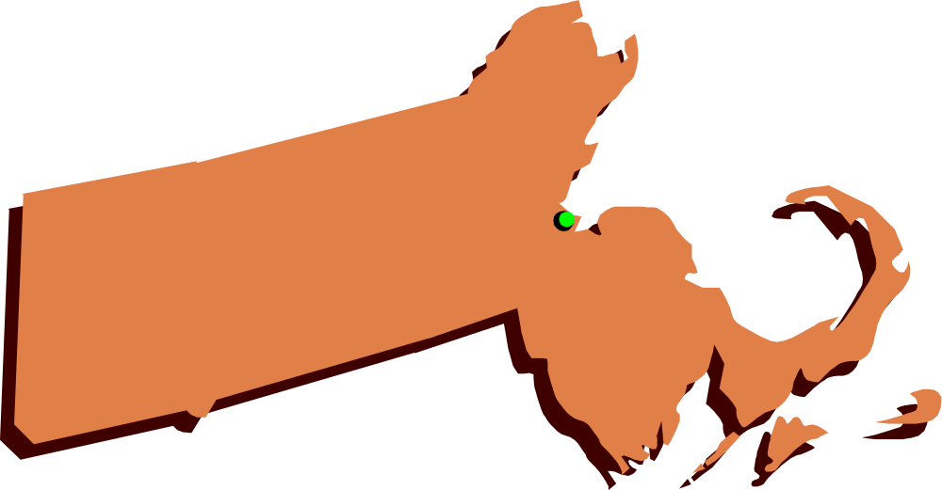
Massachusetts

Slide 103
Massachusetts
Capital:
Boston
Abbreviation:
MA

Slide 104
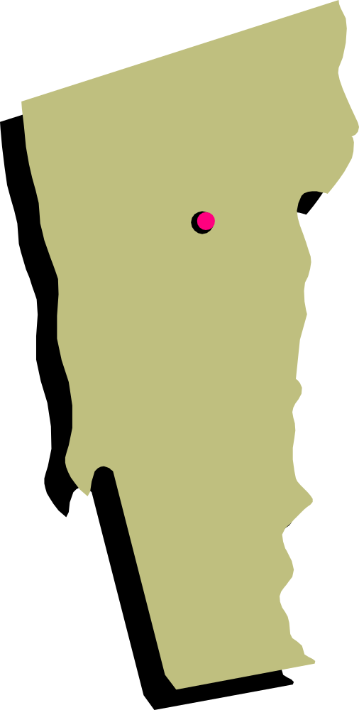
Vermont

Slide 105
Vermont
Capital:
Montpelier
Abbreviation:
VT

Slide 106

New Hampshire

Slide 107
New Hampshire
Capital:
Concord
Abbreviation:
NH

Slide 108
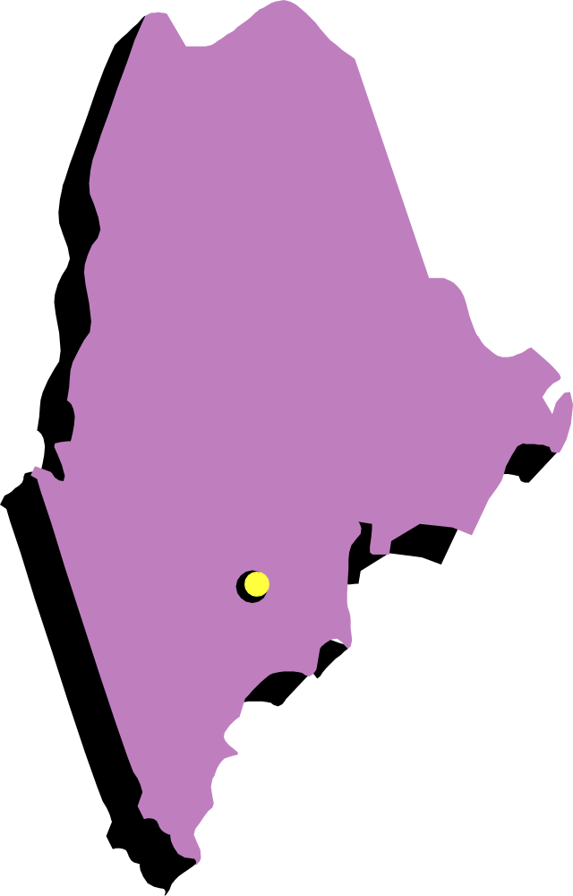
Maine

Slide 109
Maine
Capital:
Augusta
Abbreviation:
ME

Slide 110
Clip art courtesy of Microsoft Office Online http://office.microsoft.com/clipart/

